Slide 1
Technical Support (420-1N6-AB) Hardware Introduction (Pt. 2)
Fall 2022

Slide 2
Hardware – Inner Components

Slide 3
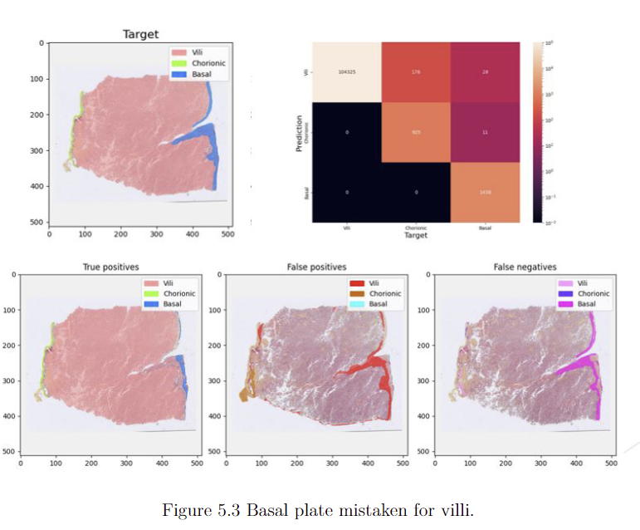
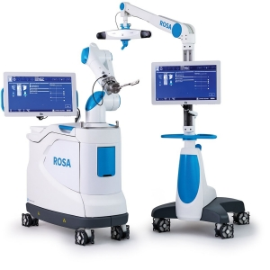
Teacher introduction
Youmna Badawy P-235

Slide 4
What aout you?
A sentence to describe your personality
What High school you went to?
What interests in you in computer science

Slide 5

Question – Query
Have you ever looked inside your own computer?
(or someone else’s)
For what reason?
What did you see inside?

Slide 6
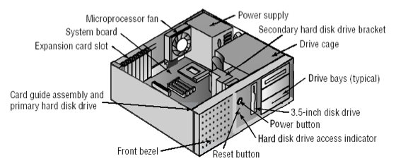
Inside A Computer

Slide 7
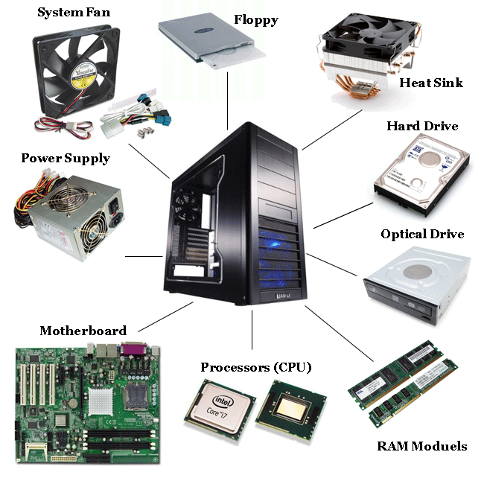
Internal Components
Case
Power Supply
Motherboard
Connectors
Cooling Devices
Processor (CPU)
Chipset
Buses
Memory (RAM)
Storage Devices

Slide 8
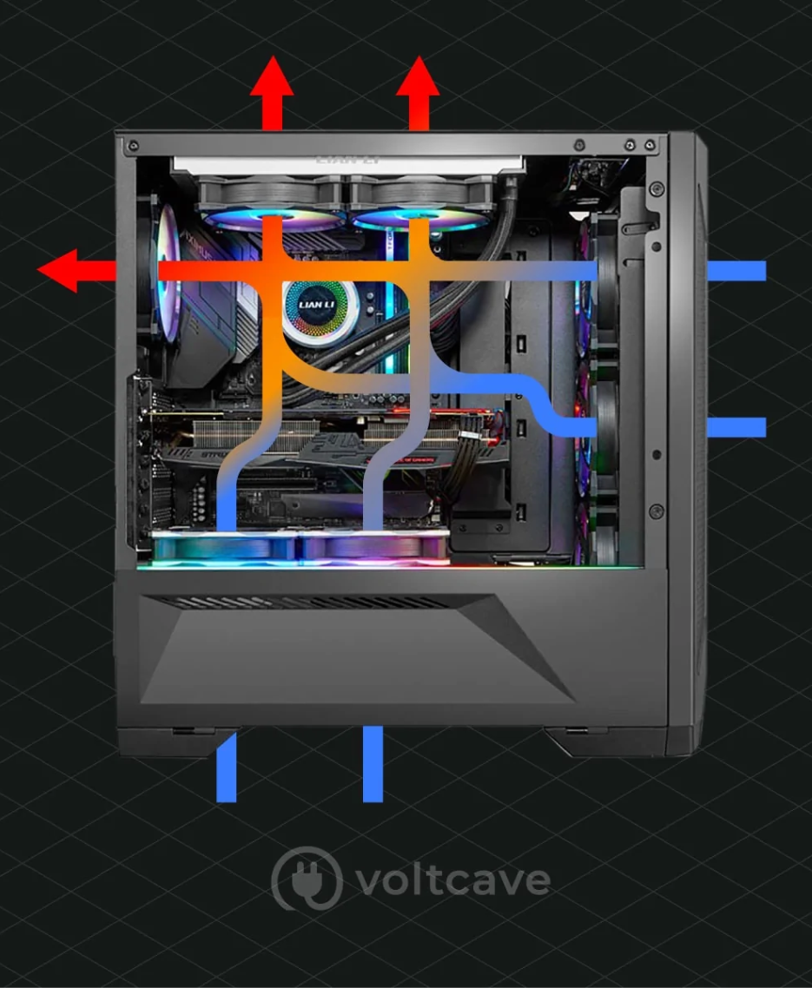
Internal Components: Case
Provides protection and cooling for the internal components.
Also prevents damage from static electricity (components grounded via attachment to case).
Usually made of plastic, steel or aluminum.
Fans move air through the case:
to replace warm air with cold air to keep components at stable temperatures
to prevent build-up of dust
There exist many guides/studies for optimal airflow. E.g. https://voltcave.com/pc-airflow-guide/

Slide 9
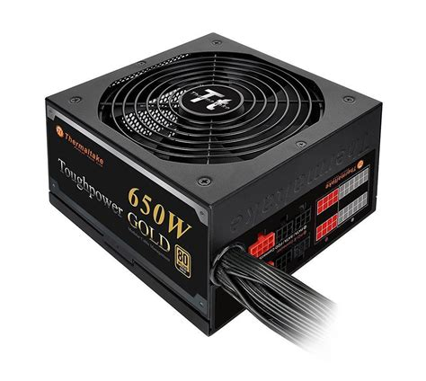
Internal Components: Power Supply
Main purpose: Converts AC power (alternating current) from wall socket to DC power (direct current). Direct current (0 or 5V) is used to power digital circuits.
Computers can only tolerate slight fluctuations in power without needing to shut down
In the case of a power outage, an Uninterruptible Power Supply (UPS) can keep a computer running for a few minutes to several hours depending on the sophistication of the UPS. See https://www.wikihow.com/Buy-and-Use-an-Uninterruptible-Power-Supply for an example.
Important: Never open a power supply! The capacitors contained within can keep a dangerous high voltage, high power charge long after being unplugged.
Ratings:
Wattage (amount of power delivered, must be greater than the sum of power required by all parts, some power supplies can provide more power than others)
Efficiency (Law of thermodynamics: 100% power input cannot be converted to 100% power output; some power supplies have higher efficiency ratings than others)
For more detailed explanation: https://www.newegg.com/insider/how-to-choose-a-pc-power-supply-buying-guide/

Slide 10
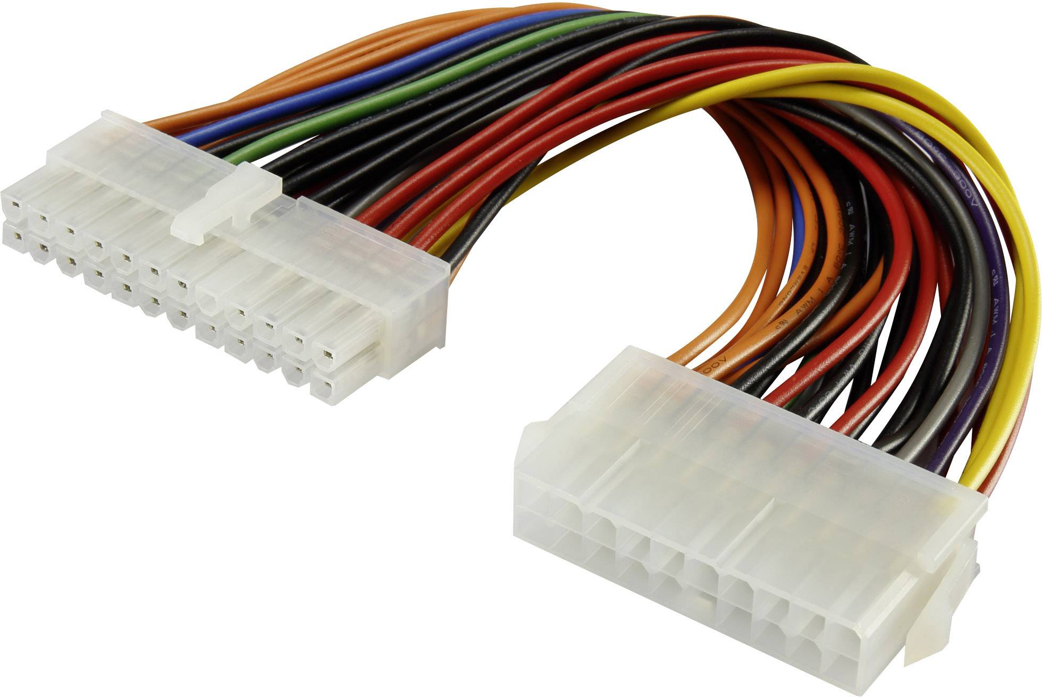
Internal Components: Connectors
These connect specific components to various ports on the motherboard.
Most connectors are keyed (can only be inserted one way).
Note: Always check the pins if you have trouble with a connector. “If it doesn’t go in like butter, it doesn’t go in at all” -- never force a connection! you are likely going to damage the pins.

Slide 11
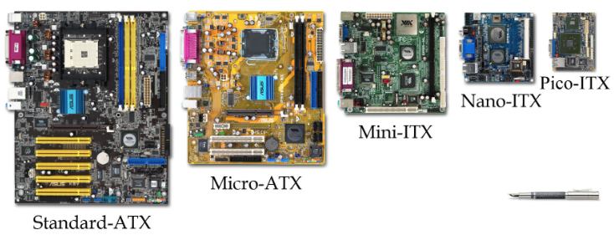
Internal Components: Motherboard
Main circuit board and controls the electrical pathways (buses) found in a computer.
The buses allow data to travel between the various components of a computer.
Various form factors, e.g. AT, ATX, LPX, BTX, ITX.

Slide 12
Internal Components: Motherboard – Form Factors (I)
AT
Invented by IBM in early 1980s, now obsolete.
Huge in size (approximately 12 x 13 inches).
Needed lots of space for power supply and its various chips.
Lacked external ports, only allowed for monitor and keyboard.
ATX
Created in 1995 to meet the need for more connectors.
Got off to a slow start but by 1998 became the most common form factor.
Biggest change to AT was the rear panel with standard set of ports for expansion.
Power supply position for better airflow, CPU and RAM positioned for easier access.
Variations 12x9in (full size), 9.6x9.6in (microATX), 9x7.5in (FlexATX no longer used).

Slide 13
Internal Components: Motherboard – Form Factors (II)
ITX
Created in 2001 to meet the demand for smaller computers.
ITX failed but led to development of smaller form factor (SSF) motherboards.
MiniITX (6.7x6.7in), NanoITX (4.7x4.7in) and PicoITX (3.8x2.8in)
Commonly used for embedded systems and specialized devices such as routers.
Require very little power, therefore produce less heat.
Proprietary
Some computer manufacturers make motherboards that work only with their cases.
Services and upgrades usually need to be handled by authorized dealers.
Often hard to get replacement parts and they are usually expensive.

Slide 14
Internal Components: Chipset
Important set of components on the motherboard.
Composed of various integrated circuits which control how the system hardware interacts with the CPU and the motherboard.
Most chipsets are divided into two distinct components:
Northbridge: controls access to the RAM and video card.
Southbridge: allows CPU to communicate with hard drive, sound card and I/O ports.

Slide 15
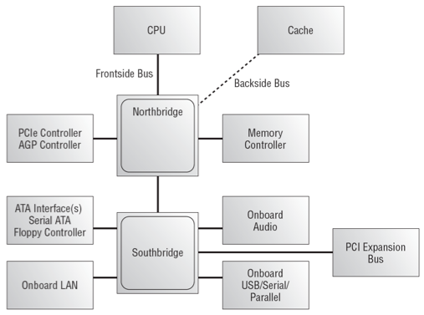
Internal Components: Chipset

Slide 16
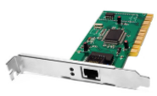
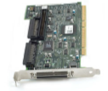
Internal Components: Expansion Slots
Expansion slots allow us to increase the functionality of a computer by adding controllers for specific devices (often called adapter cards) e.g. sound, video, NIC (network Interface Card).
PCI used in most computers, 32 or 64 bit
AGP designed to be used by video adapters
PCIe replacing AGP in newer computers
ISA older, rarely used, 8 or 16 bit
EISA older, rarely used, 32 bit
MCA IBM proprietary 32 bit, older, rarely used
PCI-X 32 bit, can run up to four times faster than PCI
MiniPCI 32 bit, used by laptops, has three different form factors

Slide 17
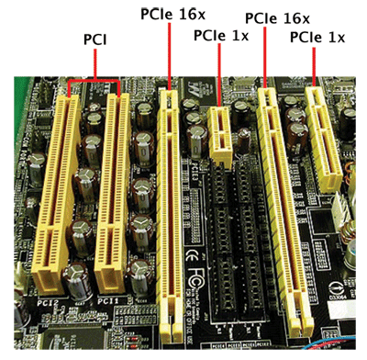
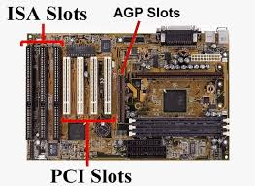
Internal Components: Expansion Slots

Slide 18
Internal Components: Buses
Buses are electronic pathways that carry information between the various devices inside a computer.
The two factors that affect a bus are its width (how many bits of information fit on the bus?) and speed (how many bits can pass through per second?).
Think of cars travelling on a highway: how many lanes are there? what is the speed limit?

Slide 19
Internal Components: Cooling Devices
The flow of current between the electronic components generates heat.
Fans inside the case increase airflow and removes heat.
Heat sinks also draw heat away from the CPU core.
A heat sink is a piece of copper or aluminum that resides between the processor and the CPU fan.
It absorbs the heat from the processor and the fan disperses the heat.
Occasionally video cards or other components have their own fans to cool them.

Slide 20
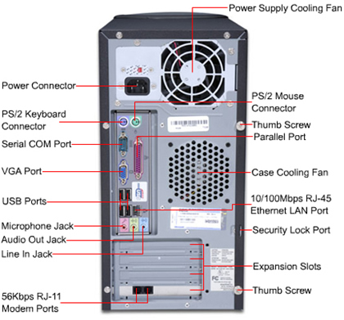
Activity: Feeling Your Way
With a partner, take it in turns to close your eyes and feel around the back of a PC.
Try and identify the connectors you find. Your partner can help you by confirming your guesses.

Slide 21
Activity: Looking At Internal Components
Desktop
Power supply
Motherboard
Cooling devices
Processor (CPU)
Optical drive
Memory (RAM)
Expansion slots
Voltage regulators
Buses
Laptop
Battery
Motherboard
Cooling devices
Processor (CPU)
Hard drive
Optical drive
Memory (RAM)
Keyboard
Buses
What other components can you identify?

Slide 22
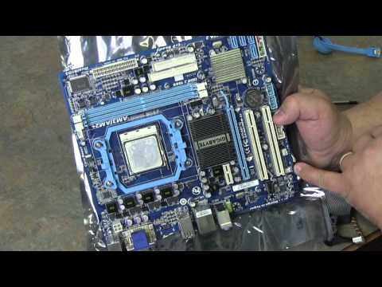
Video: Taking A Computer Apart
(28 mins)

Slide 23
Processor (CPU)
Most important element of the computer in terms of computing power.
Common CPU manufacturers are Intel and AMD.
The CPU is connected to the motherboard in one of two ways:
PGA: pin grid array - pins on underside of the processor.
LGA: land grid array - pins on socket instead of on the processor.

Slide 24
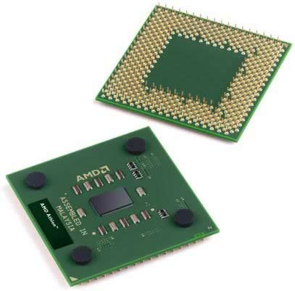
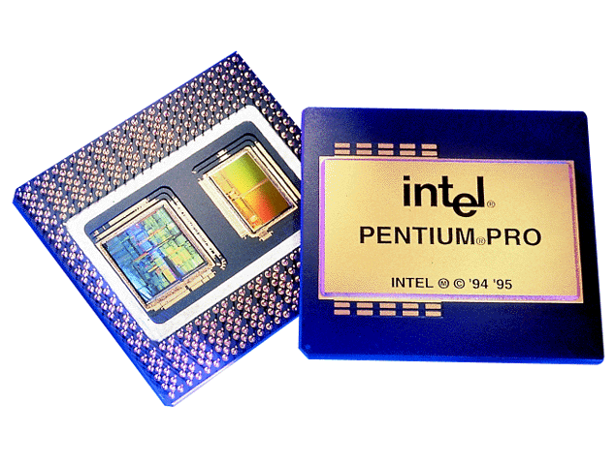
Processor (CPU) (cont.)
CPU (Central Processing Unit)
A complex collection of electronic circuits on one or more integrated circuits (chips) which:
Executes the instructions in a software program.
Communicates with other parts of the computer system, especially RAM and input devices.
Let’s have a deeper look.

Slide 25
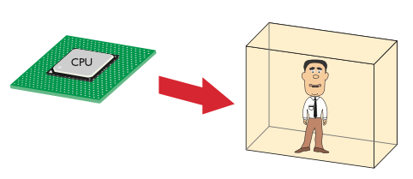
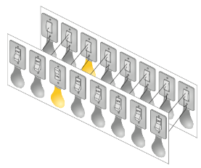
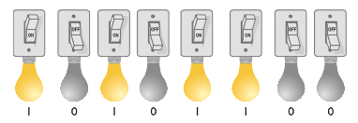
CPU Core Components
“Man-in-a-box”
Clever guy who can perform any mathematical function quickly.
He lives in a closed-up box so it is hard to communicate with him.

Slide 26
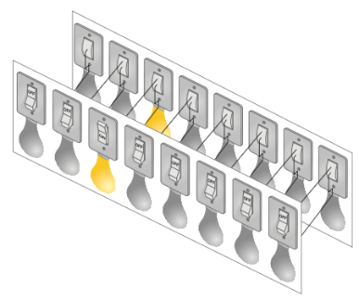
CPU Analogy: “Man in a Box”
Imagine we install a set of 16 lightbulbs
(8 inside, 8 outside).
These can be controlled by us and by the man-in-the-box. This is our external data bus (EDB).
We can communicate with each other as long as we agree ahead of time what each pattern of light bulbs means.

Slide 27
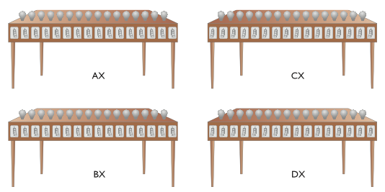
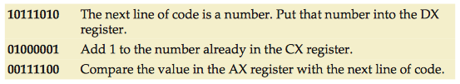
Registers & Codebook
Registers
We can give the man some work and see what he replies.
But to do his work, the man needs at least four workstations.
General purpose registers are the most common. AX, BX, CX, DX (Intel).
Codebook
This defines the commands that we can give to the man in the box.
If we both have a copy, then we can give him commands and he can understand them.

Slide 28
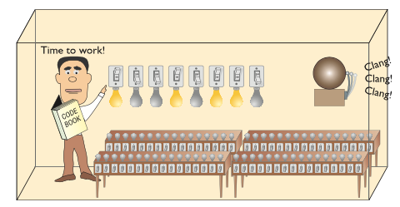
Clock
Now we are ready to put our man to work. We can send him the first command by lighting up the wires on the EDB.
But how does he know when we have finished setting up the light bulbs?

Slide 29
Clock
We can use a bell activated by a button.
A real computer uses a special wire called the clock wire (CLK). For the CPU to process a command on the EDB, a certain minimum charge is applied to the CLK wire. This is called a clock cycle.
The maximum number of clock cycles a CPU can handle in given period of time is called the clock speed.

Slide 30
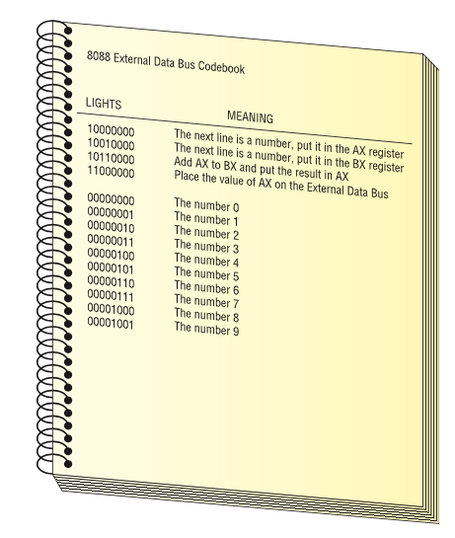
CPU Core Components: Activity
Using the following codebook, ask the “Man in a box” to calculate 2+3
You must send a series of commands to the CPU. The CPU will act on each command and give you an answer.

Slide 31
CPU Core Components: Activity (cont.)
10000000 The next line is a number, put it in the AX register 00000010 The number 2 10010000 The next line is a number, put it in the BX register 00000011 The number 3 10110000 Add AX to BX and put the result in AX 11000000 Place the value of AX on the external data bus
A set of commands such as this is called a program. A program is a series of command sent to a CPU in a specific order for the CPU to perform work.

Slide 32
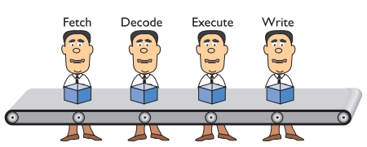
Pipelining
The CPU takes at least four steps (called stages) to do something. Small discrete circuits inside the CPU handle each of these stages.
By organising these circuits in a conveyor-belt fashion (called pipelining), our “man-in-a-box” becomes “men-in-a-box”, thus improving efficiency.
Helps system to run faster. Not perfect and sometimes stalls. Some CPUs therefore have multiple pipelines.

Slide 33
More Hardware Components to Discuss
More on CPU.
GPU.
Memory
Storage Devices.

Slide 34
Q & A
Notes:
In Slide Show mode, click the arrow to enter the PowerPoint Getting Started Center.

